Slide 1
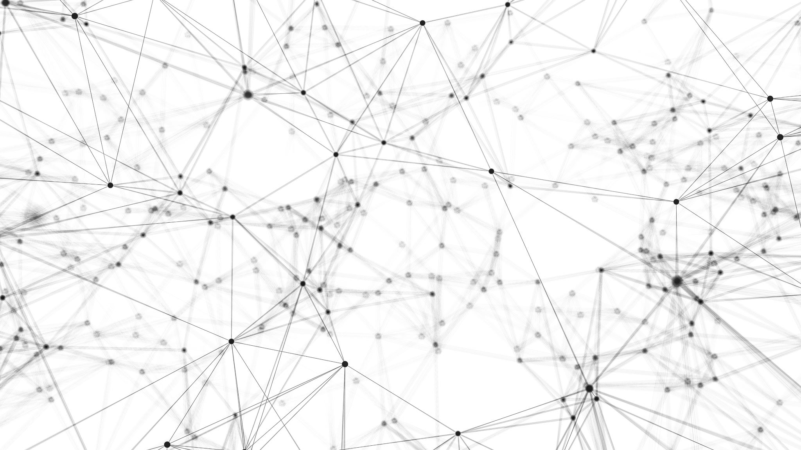
Introduction to AI, Spring 2023 Philosophical Underpinnings

Slide 2
What is AI?
What do you think?

Slide 3
Some Food for Thought… How do we recognize intelligence?
How do I know that I am intelligent?
How do I know that someone else is intelligent?
Is the human brain a machine?
Can an electromechanical machine that processes like the brain have a mind?
Can an electromechanical machine that acts like a brain have a mind?
Can a machine have consciousness?

Slide 4
The Foundations of Artificial Intelligence
Many influences
Philosophy
Mathematics
Economics
Neuroscience
Psychology
Computer Engineering
Control Theory and Cybernetics
Linguistics
Notes:
Many disciplines contributed ideas, viewpoints, and techniques to AI!
--Philosophy: Dealing with issues such as ‘how does the mind arise from the physical brain’, ‘where does knowledge come from’ , and ‘how does knowledge lead to action’
--Mathematics – What can be computed? How do we reason with uncertain information?
--Economics – How should we make decisions to maximize payoff
--Neuroscience – how do brains process information
--Psychology – How do humans and animals think and act? Cognitive psychology – brain as information processing device.
--Computer Engineering – How can we build an efficient computer
--Control Theory and Cybernetics – How can artifacts operate under their own control?
--Linguistics – How does language relate to thought?
As you can see, AI is a confluence of varied, rich, deep fields!

Slide 5
Digging into some specific ‘isms’ that shaped the field (Philosophy)
Rationalism: Using the power of reasoning to understand the world.
Dualism: Bodies are made of physical substance, minds are made of ethereal mental substance.
Materialism: An alternative to Dualism. Brain is still operating according to physics!
Empiricism: “Nothing is in the understanding, which was not first in the senses” – John Locke
Logical Positivism: All knowledge can be characterized by logical theories connected to “observational sentences” (sensory input)
Notes:
Rationalism: Aristotle and Leibnitz and Descartes (Descartes is ‘I think therefore I am’). Tied to the notion of free will – we reason to think about the world and behave within it. If the mind was purely a physical conception, governed entirely by physical law, then it has no more free will than a rock “deciding” to fall toward the center of the earth.
Dualism: there there’s a part of the human mind (or spirit, or soul) that exists outside of nature, exempt from physical laws.
Materialism: brain is operating according to physics, and THAT’S what constitutes the mind! Free will is just the way that the perception of available choices appears to the person or animal or whatever doing the choosing.
The above is about the mind establishing knowledge, now we move in to the sources of knowledge.
Empiricism: Nothing is in the understanding which was not first in the senses.
Logical Positivism: Everything knowable can be constructed through logic, where any given truth is connected to sensory input. Combination of rationalism and Empiricism. We take what we observe (empiricism) and use that to reason about new things that perhaps we haven’t observed (rationalism).

Slide 6
Digging into some specific ‘isms’ that shaped the field (Psychology)
Mentalism: Minds should be described by their internal states, such as thoughts and beliefs.
Behaviorism: We cannot directly observe the mind; should only concern ourselves with observable behaviors.
Notes:
Mentalism: That a mind is made up of these thoughts and beliefs! That introspection on the thought process is very important! That’s a difficult enough task for humans (lots of subjectivity involved, vocalizing your thought process), but couldn’t work at all for animals (because we can’t hear/understand them)!
Behaviorism: Introspection can’t provide reliable results, the internal working of the mind can’t be observed. Behaviorism is all about looking at the actions that a being takes. If you are familiar with B.F. Skinner, he did a lot of work for Behaviorism. Seeing and observing and cataloguing the stimuli on a creature, and the response that is produced. This taught us a lot about rats and pigeons, but led to less success about understanding humans.

Slide 7
Weak AI vs. Strong AI
Weak AI: Machines can act as if they are intelligent.
Alternatively: good at specific things.
Strong AI: If it appears to do this, then it is actually thinking (and not just simulating thinking)
Alternatively: Good at all tasks.
Notes:
So, if those previous slides didn’t prime you, there’s going to be a lot of vocabulary in this class, and a lot of terms and phrases. One common term you might have already heard is Weak AI vs Strong AI
These are both used to refer to different philosophical arguments, as well as a way of describing specific AI systems.
Although, that said, many AI researchers take the Weak hypothesis for granted (“of *course* they can act as if they are intelligent) and don’t concern themselves with the Strong AI hypothesis (as long as the program works who cares if you call it a simulation of intelligence or real intelligence?). But even if many AI researchers don’t concern themselves with it, this actually gets at some pretty heady ethical ramifications of AI programming, and the very nature of consciousness itself.

Slide 8
The Chinese Room
Notes:
Connected to this idea is a famous thought experiment by John Searle.
Imagine if you will a room with no windows or other way of seeing into the outside world. In the original this room is in China, but that’s less important. It could be France, Or Mars, or anywhere. In this room is a person who *does not speak or understand the language* AT ALL, but outside of the room, everyone speaks and understands it. Into this room, messages in this foreign language are sent in. The poor person in the room has no understanding of them whatsoever. However, they have a giant book, perhaps infinitely impossibly large, that tells them to write certain things down, and send them back out into the outside world. What is written makes perfect sense in response to whatever input was initially provided.

Slide 9
The Chinese Room
Proposed by John Searle in 1980
Does the person in the room understand Chinese?
Does the rule book understand Chinese?
Does the room understand Chinese?
Searle uses this to claim: brains cause minds, and while other machines might also cause minds, programs do not.
Notes:
So, we can hopefully see some of the parallels here between a black box program…
We have the input and output…
The Human is the CPU
The rule book is the program,
Human does not understand Chinese, and the rule book is just a big thing of paper, so it doesn’t understand Chinese, therefore, there’s no understanding of Chinese going on here. Even though to outside observers, it certainly feels like *something* about the room is understanding Chinese! THUS – even though the program is running “correctly”, it doesn’t necessarily mean that there is understanding.
This is controversial for a number of reasons (water is wet, although hydrogen and oxygen are not – the whole can have qualities that the constitutive parts do not). The notion that perhaps this is exactly how humans behave – you say something to be, it goes into the “Chinese Room” of my brain where processes that I can “follow” but not “understand” exist, and I produce output. Searle says that isn’t what he believes, that even if the human brain is running some “AI” program that there’s still something special happening at the level of neurons that distinguishes us. But what that is exactly, is left unspecified. And so, the question of “what’s there to be a mind”? Remains a great mystery.

Slide 10
Four Approaches to AI
Acting Humanly
Thinking Humanly
Thinking Rationally
Acting Rationally

Slide 11
Acting Humanly – getting computers to do things which people are better at.
Turing Test: Converse with either a human or a computer, must guess which it is.
Maybe not a “perfect” test.
But showcases myriad application areas.
Natural Language Processing
Knowledge Representation
Automated Reasoning
Machine Learning
Computer Vision
Robotics
Notes:
Proposed by Alan Turing in 1950
NLP – to “hear” what is being said, and to “write” what the answer is.
Knowledge Representation: To Store what it knows or hears.
Automated reasoning: Use Stored information to answr questions and draw new conclusions.
Machine Learning: Adapt to new circumstances, detect and extrapolate patterns.
Original had no physical interaction—not necessary for intelligence was the claim—but imagine if you will the TOTAL TURING TEST with visual sensors, and the ability for the human to pass things through the hatch
Computer Vision: To perceive objects
Robotics: manipulate, move the object around.

Slide 12
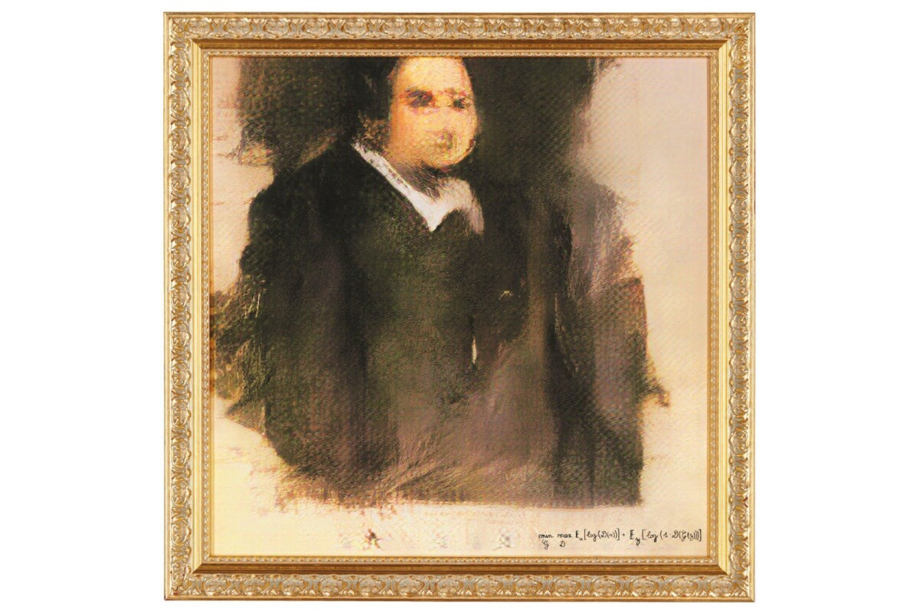
Thinking Humanly – The automation of activities we associate with human thinking.
Intimately tied with cognitive psychology.
As previously discussed – we aren’t necessarily entirely sure how the human brain works itself!
Not just about solving the problem.
Beautiful art and “Mere Generation.”
https://newatlas.com/ai-art-auction-obvious-belamy/56984/
Notes:
Intimately tied with cognitive psychology (scientific study of mental processes, e.g., “attention”, “language use”, “creativity”, and “thinking”) – the two fields helped accelerate research with each other.
Cognitive psychology is worthy many classes unto itself!
But the idea is – not being content with just having the problem solved – want to see the reasoning behind the computer’s solution, and compare if the computer’s reasoning was similar to a humans. For example, let’s imagine that you create an AI that has an algorithm that is capable of producing beautiful, amazing artwork. It’s reasonable to assume that, wow, awesome, cool! I have a machine that can do this cool thing, I’m done! AI researchers concerned with thinking humanly aren’t content unless the algorithm which produced that art in some way captures the process the process of a human producing that same artwork. If it doesn’t, it is considered “mere generation.”
Portrait – developed using generative adversarial networks (GANs) – based on a data set of real life protraits, combined with a “discriminator” that tries to rule out ‘bad’ examples. Sold for over $400,000 dollars at an art auction.
--And this is a fast moving field – compare that with the controversies surrounding AI generated art today, where many artists are justifiably feeling like their work has unfairly been used to feed AI artists.

Slide 13
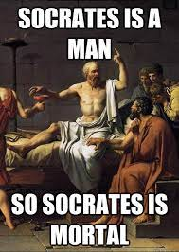
Thinking Rationally – The “laws of thought” approach
Provably correct procedures for gaining new knowledge.
E.g., logical deduction:
If we know: Socrates is a man; all men a mortal.
We can conclude: Socrates is mortal
Computer programs have authored new mathematical proofs!
But two big issues
Real world is messy
Computationally intractable
Notes:
Starting with what you do know, these atomic facts in the world, and building off of those atomic facts to discover new facts.
This is cool and powerful, and this approach has been used to author new mathematical proofs!
However, there’s a couple of major stumbling blocks with this approach. The real world is messy and hard to formalize – it’s tough to break things down into those little tiny atomic truths like that! Especially when dealing with knowledge that is less than 100% certain!
The second is that this approach is computationally intractable – as you start building up more and more of these facts, it’s hard to know what steps to try first, but without knowledge of heuristics you might spend a lot of resources going down a “bad path”.

Slide 14
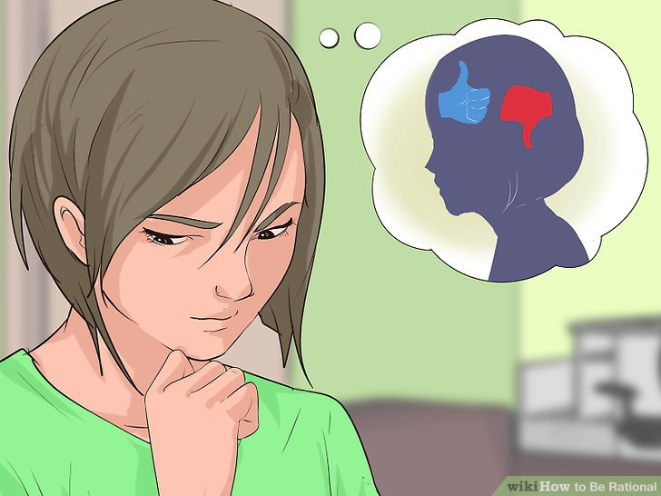

Acting Rationally – Intelligent Behavior in Artifacts
Rationality: Doing the Right Thing, given what you know.
This approach depends on performance measures and agents.
A performance measure: some way of evaluating how “good” you are doing.
An agent: something that acts.
A rational agent, then, is one that acts to achieve the best outcome (or best expected outcome)
More general than “laws of thought”
This is the most common approach, and what the book is most concerned with.
Notes:
Rationality definition: maybe allude to omniscience later on.
Performance measure is something we’ll be talking about a lot in the future – it’s basically a way of evaluating how “good” of a job an agent is doing.
And by agent we just mean, something that acts. And although you could say that ANY computer program ”does something”, the notion of a computer agent is expected to do more: operate autonomously, perceive their environment, persist over a long time period, adapt to change, create and pursue goals.
Rational Agent: trying to figure out the best thing to do. Though as we’ll see, there may be situations where there is uncertainy involved, in which case it is just trying to “do its best” as it were.
More general than “laws of thought” – this includes it (sometimes logical inference is to think rationally) but this includes more things. For example, putting your hand on a hot stove and immediately recoiling as a reflex is probably going to evaluate higher on your performance measure than thinking of a lot of logical deductions and careful deliberation.

Slide 15
Ethics and Concerns – for Humans!
Loss of jobs
Loss of human uniqueness
AI used for Evil
Loss of Accountability
End of the human race
Notes:
Bank programs, grocery store checkout, etc. – but the idea that this frees up humans displaced from old jobs to now do more exciting/fulfilling jobs is the main argument.
May prove that thing that we were talking about with the Chinese room – that humans ARE automata basically. But mankind has faced similar threats to our ego (Earth isn’t the center of the solar system, we’re biologically connected to apes, etc.)
The fear that advanced technology will be used by the powerful to suppress their rivals. One can make the claim that this is like a “medieval helmet” taken to extreme ends. No moral objection to wearing a helmet against other warriors. certainly no objection to that So are AI based drone warfare really so different than a technology advance meant to protect combatants? But still, there could be issues. What if your nation had the very best helmets – it might be inclined to go to war more often through a sense of overconfience; advanced technology could continue with that too leading to reckless, unnecessary war and fighting. But other things too – surveillance, loss of privacy, and there are many people debating what the best course of that is, ranging from “you never had privacy anyway, get over it” to making the surveillance available for all.
If a doctor relies on an AI to help administer medicine, and the diagnosis is wrong, who is at fault, the human or the doctor? At present, systems like this are considered the same as textbooks – physician is responsible for understanding the reasoning. This ties in also with ideas of creating systems, and unexpected bias creeping in. This can be seen with hiring decisions happening at Amazon.
From Frankenstein to Terminator to Matrix, we have artificial life being a threat to humanity – the idea that they represent the unknown (and, perhaps, our hubris, as opposed to other end of the world scenarios such as aliens attacking). There could be state estimation errors: an autonomous car misreads a lane, causing a car accident. An automated missile system misreads an incoming attack, and launches its missiles, causing an international incident. But, in theory, these aren’t *more* dangerous or *more* possible than with humans at the helm. And a system of “checks and balances” in place could help mitigate this. There’s also the idea of “performance measures” we talked about, or “utility functions” – these are hard to write. Let’s say you write “minimize human suffering” – but humans are REAL GOOD at finding problems, even in paradise. So the optimal solution is to terminate the human race as quickly as possible to end all suffering! No humans, no suffering! Or for those of you who took game dev last semester, “Universal Paperclips” was predicated on the notion of an AI whose utility was predicated on the number of paperclips produced. So, ah, writing good utility functions is very important! And also, hopefully that if the robot has been programmed to be capable of deducing “end humans to end suffering”, it is ALSO smart enough to deduce that “minimize human suffering” did not INTEND that.
There’s a third point, that is the most unique to AI – the notion of the singularity – that a machine can “learn” to the point that it develops unintended behavior. People have predicted the singularity happening as early as 2023, but this feels unlikely. Technology grows quickly but then tapers off. Sometimes we hit hard limits. It’s difficult, at present, to know what the future will hold in this regard.

Slide 16
A Final “Ism”
Transhumanism: Biotech and robotics creates a fundamental change in human nature.
Notes:
Some people relish the singularity. A glorious future where we transcend the limitations of the physical. But of course, with all of us augmented, what’s to say that we won’t also augment human’s destructive inclinations.

Slide 17
A Sneak Peak at Some of the Topics of the Course
Planning: Façade and Best Laid Plans

Slide 18
A Sneak Peak at Some of the Topics of the Course
Search: The Palladian Grammar
Notes:
Generative, parametric techniques to construct architectures of Villas!

Slide 19
A Sneak Peak at Some of the Topics of the Course
Constraint Solving: Refraction

Slide 20
A Sneak Peak at Some of the Topics of the Course
Neural Networks: Pix2Pix

Slide 21
I’m Looking Forward to it!
And I hope you are too!
Notes:
There’s a lot to learn!

